Slide 1
Binaural Hearing, Ear Canals, and Headphone Equalization
David Griesinger
Harman Specialty Group

Slide 2
Two closely related Threads:
1. How can we capture the complete sonic impression of music in a hall, so that halls can be compared with (possibly blind) A/B comparisons?
  Can we record exactly what we are hearing, and reproduce it later with fidelity?
  If so, will these recordings have the same meaning for other people?
2. What is the physics of the outer ear?
  By what mechanisms do we perceive externalization, azimuth, elevation, and timbre?
  Are there mis-assumptions in the conventional thinking about these subjects – and can we do better?

Slide 3
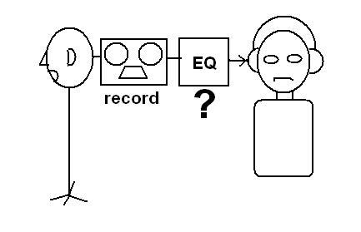
Part 1 - Binaural Capture
Has a long History – at least since Schroeder and Sibrasse
  Idea is simple – record a scene with a microphone that resembles a head, and play the sound back through headphones
  But who’s head do we use? How are microphones placed within it? What equalization do you need to match the headphones to the listener?
  Most people think it is possible to equalize the dummy-headphone system by placing the headphones on the dummy, and adjusting for flat response.
  Unfortunately – this does not work. The dummy and the listener have completely different ear canal geometry – and the equalization is grossly in error.

Slide 4
Some History
Schroeder attempted to solve the headphone equalization problem by playing back the recording through loudspeakers, with electronic cancellation of the crosstalk between the ears.
  The result sounds spatially much like headphones, but the listener can use his own ear canals and pinna.
  Unfortunately there are TWO pinna in the playback – the dummy’s and the listener’s.
  And the equalization of the dummy head is still unknown.
The Neumann KU80 dummy in the front of the room is similar to the dummy used by Schroeder.
  Note that the pinna are not particularly anthropromorphic, and there are no ear canals at all.
  The frequency response (relative to human hearing) of such a head can be different by more than 20dB at mid frequencies.

Slide 5
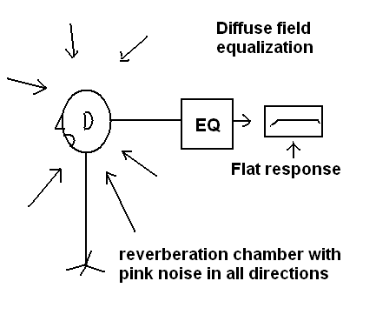
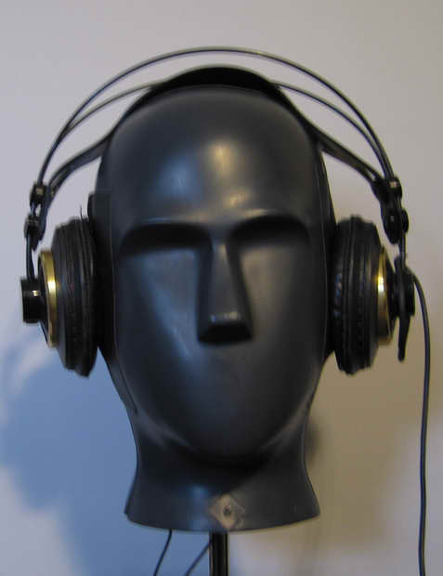
Theile – Spikofski
Spikofski’s work at the IRT Munich promoted the idea of “diffuse field equalization” as the natural standard for both dummy head recording and headphone reproduction. The result was implemented in the Neumann KU-81 dummy microphone. I went right out and bought one!
To equalize headphones, put them on the equalized dummy, and adjust the headphone equalization until a flat response is achieved. Good Luck…
Check out the KU-81 pinna and couplers.
Note the ear canal entrance is very different from yours.

Slide 6
But the method did not work for me! ☹
Perhaps the pinna were not close enough to mine?
  So I replaced the pinna with castings of my own. Still no go.
Theile published a comprehensive paper on the subject, which suggested that one could make an individual headphone calibration by putting a small microphone in the ear canal (partially blocking it) and then matching the headphones to a diffuse acoustic field.
  But this also did not work for me. The resulting headphone equalization was far from natural, and unbalanced between the two ears.
Theile’s arguments however were compelling:
  It should not be necessary to measure the sound pressure at the eardrum if one was only trying to match the sound pressure at the entrance of the ear canal to an external sound field.
Blocked ear canal measurements became an IEC standard for headphone calibration.

Slide 7
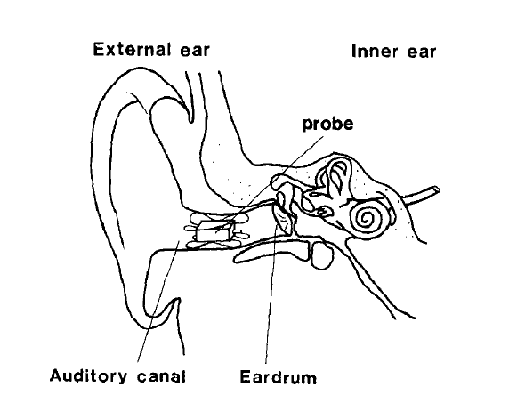
Theile’s method
Note that the ear canal is (as usual) represented as a cylinder

Slide 8
More on diffuse field
Theile’s arguments for diffuse field eq go this way:
  If headphones are equalized to match a frontal HRTF of an average listener, then ordinary stereo signals will have no room sound, and be very dry and unnatural.
  Since such signals are intended to be heard in a room – at some distance from the speakers – the headphones should be equalized to match the total sound pressure in the room.
  This implies [maybe] that diffuse field equalization is correct for heaphones.
If headphones are equalized for the diffuse field, then dummy heads need to be equalized for the diffuse field.
    In this case a dummy head recording will be correctly reproduced over headphones. But not over loudspeakers!
    Alas – this argument requires that a dummy head equalized for loudspeakers must be equalized to be flat in a free field for signals from the front. You can’t have it both ways…
The author published a paper on this subject 20 years ago, and had personal conversations with Stephan Peuss at Neumann.
    The result was the Neumann KU-100 dummy head.

Slide 9
More on Theile
Theile’s arguments for diffuse field equalization are entirely Aristotelian.
  What if a free-field frontal equalization for headphones is preferred by listeners when listening to ordinary stereo?
    In fact, diffuse field is often preferred.
  Free-field eq differs from diffuse field eq by having about 6dB less treble. Nearly all commercial headphones have more treble than even a diffuse-field eq.
    They sell better this way. Accurate is not always perceived as best.
But if free-field equalized headphones were standard, then dummy heads could also be free-field equalized.
  And would reproduce well over loudspeakers as well as over headphones.
But all these arguments are meaningless without an accurate method of measuring headphone response on a particular individual!

Slide 10
Hammershoi and Moller
An excellent paper by Hammershoi and Moller investigated whether the ear canal influenced the directional dependence of the human pinna system.
  They concluded that measuring the sound near the entrance of the ear canal captured all the directional dependence, and it was not necessary to go to the eardrum.
This paper has been taken as conclusive proof that the ear canal is not relevant for headphone equalization or dummy head recording.
  But Hammershoi and Moller say “The most immediate observation is that the variation [in sound transmission from the entrance of the ear canal to the eardrum] from subject to subject is rather high…The presence of individual differences has the consequence that for a certain frequency the transmission differs as much as 20dB between subjects.”
Thus the directional dependence as measured at a blocked ear canal can be correct – But the timbre is so incorrect that our ability to perceive these the true direction is frustrated. (And the sound can be awful..)

Slide 11
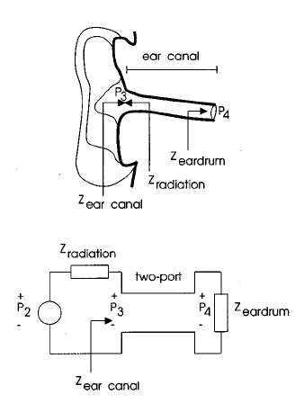
Moller’s ear canal
Hammershoi and Moller additionally say: “another observation is that the data do not tend to support the simple model of an ear canal”. But in spite of this, they present the following model:
Once again, we see that the cylindrical model has won out over data and common sense.
  They have assumed timbre does not matter – only differences in timbre.

Slide 12
The Hidden Assumption
The work of Spikofski, Theile, and Moller all rests on the assumption that human hearing rapidly adapts to even grossly unnatural timbres.
That is, the overall frequency response does not matter for localization, only relative differences in frequency response.
  Alas, this is exceedingly unlikely. It seems clear that rapid, precise sound localization would be impossible without a large group of stored frequency response expectations (HRTFs) to which an incoming sound could be rapidly compared.
Human hearing does adapt to timbre – as we will see – but adaptation takes time, and needs some kind of (usually visual) reference.

Slide 13
A Convenient Untruth
That absolute frequency response at the eardrum is unimportant for binaural reproduction is seductively convenient. But it violates common observation:
  The argument is based in part on the perceived consistency of timbre for a sound source that slowly moves around a listener.
  But perceiving timbre as independent of direction takes time. If a source moves rapidly around a listener it is correctly localized, but large variations in timbre are audible.
    Clearly the brain is using fixed response maps to determine elevation and out-of-head impression. And compensating for timbre at a later step.
  I was just in the Audubon Sanctuary in Wellfleet at 8am, surrounded by calling birds in every direction. I felt I could precisely localize them – but I could tell you nothing about their timbre.
  Walking under an overhead slot ventilator at Logan at about 3.5mph, I noticed a very strong comb-filter sound. When I retraced my steps at 1.5mph the timbre coloration was completely gone. In both cases the sound was correctly localized.
  In the absence of visual or other cues, headphones with excess treble reproduce sounds perceived as above the head.
Bottom Line: Accuracy of frequency response AT THE EARDRUM is essential for correct localization with binaural hearing.

Slide 14
Then why are binaural recordings often perceived as successful?
Binaural demonstrations are often effective – especially with sounds that are to the side or rear of the head
  Azimuth cues derived from the time delay between the two ears, and the head shadowing of the head are effective even when the timbre is grossly incorrect.
  When a sound source is rapidly moving the brain tends to ignore incorrect elevation cues if they conflict with the expected trajectory.
  If a visual cue is present at the same time it will almost always dominate the aural cues.
With some good showmanship and a subject who is willing to be convinced, these demonstrations can be quite convincing.
  But with skeptical listening frontal localization of fixed sources is rarely achieved.

Slide 15
Head Tracking
It has been noticed that standard ear-canal-independent methods of calibrating dummy heads and headphones do not work very well.
  It is almost universal that subjects claim frontal headphone images localize inside the top of the head.
However, when a dummy head tracks a listener’s head motion there is sufficient feedback that a frontal image is restored.
  Although the process may take a minute or so.
Therefore head tracking has been assumed to be an essential part of any dummy head recording system.
  But none of us need to move our heads to achieve external, frontal localization.
Head motion produces azimuth cues that are so compelling that the brain quickly learns to ignore timbre cues from the pinna. But this is not an ideal solution, as issues that depend on timbre, such as intelligibility and sound balance, are incorrectly judged.

Slide 16
More on the necessity of accurate timbre
As we will see, human hearing adapts to timbre relatively quickly.
But in my experience inaccurate timbre while monitoring a recording with headphones results in recordings that are far to reverberant.
  Intelligibility is often reduced by upward masking, which is a result of the mechanical properties of the basilar membrane.
  Boosting the treble increases the intelligibility of speech and music. This effect is not compensated by adaptation.
  This is one reason that headphones with excessive treble are often preferred. But they do not make successful recordings
    And they are misleading when used for hall research.

Slide 17
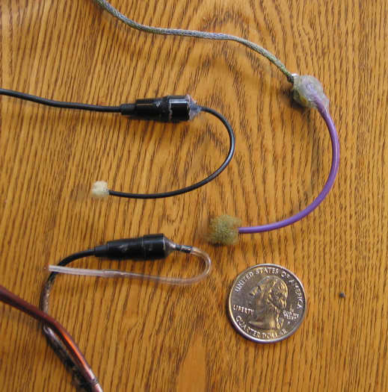
There is a headphone eq method for head recording that works!
We need to go back to basics.
  record the sound pressure at the eardrum of a listener – and then reproduce the exact same sound pressure on playback
  This is not particularly difficult. And the result can be amazingly realistic.
After failing with Theile’s method 20 years ago, the author constructed the purple probe microphone on the right to measure the sound at my own eardrum.
It is uncomfortable, but it works!
The black model to the left is a probe from 3 years ago. It works well, but is slightly uncomfortable, and the S/N is not great.
The bottom one is the latest. It is comfortable and works well.

Slide 18
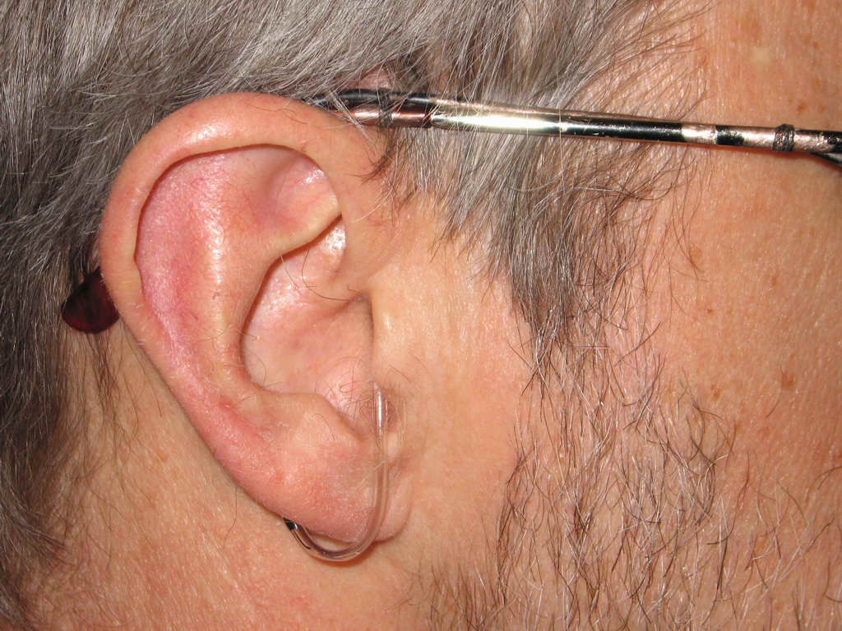
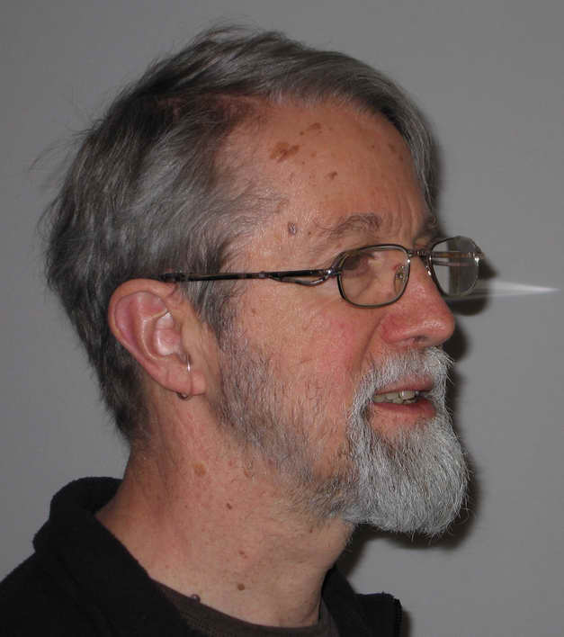
Probe Microphones 1mm from the eardrum
Compact probe microphones can sit very close to the eardrum with no discomfort, and no disturbance of normal hearing.
They are also quite discrete

Slide 19
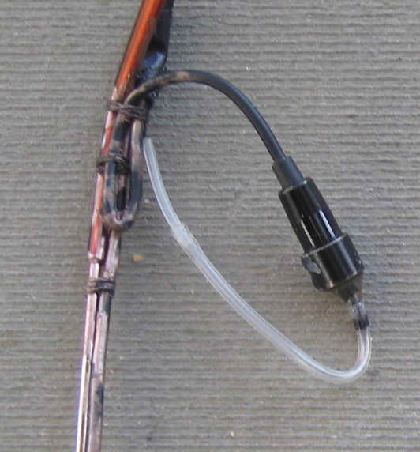
Probe construction
The probe mike is made from a Radio Shack Lavaliere microphone with a 6cm length of 18 gage PVC clear tubing glued with epoxy to the end. The PVC is hard enough that there is no sound leakage through the tube – a problem when the whole tube is silicon.
A ~1cm length of ultra-soft silicon medical tubing is then press-fit into the slightly expanded end of the tubing, and cut to length so it sits just in front of the eardrum.
The silicon is soft enough that it can be touched to the eardrum without consequences!

Slide 20
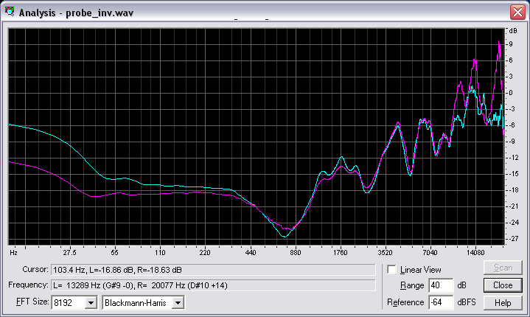
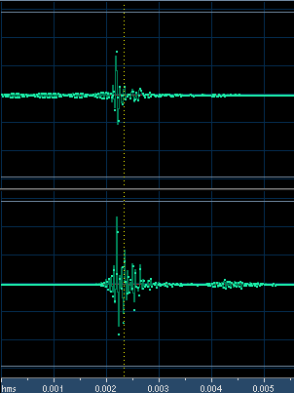
Probe Equalization
This graph shows the frequency response and time response of the digital inverse of the two probes as measured against a B&K 4133 microphone.
Matlab is used to construct the precise digital inverse of the probe response, both in frequency and in time. The resulting probe response is flat from ~25Hz to 17kHz. In general, I prefer NOT to use a mathematical inverse response, as these frequently contain audible artifacts. I minimized these artifacts here by carefully truncating the measured response as a function of frequency.

Slide 21
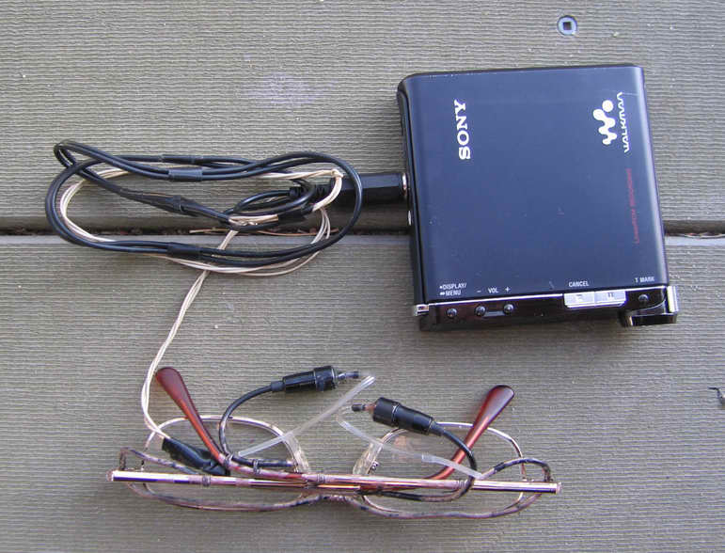
Recording
Completed probe system plugs directly into a professional minidisk recorder.
4 hrs of compressed audio, or 1 hour of PCM can be recorded on a single 1GB disk.
Record level can be digitally calibrated for accurate SPL.

Slide 22
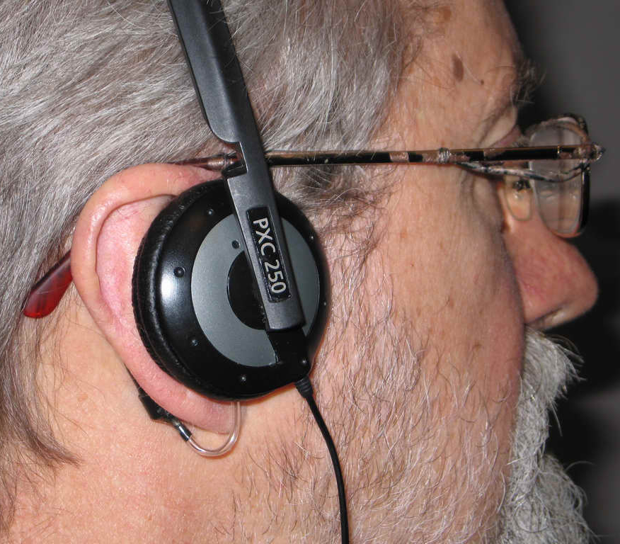
Equalization of the playback headphones
Carefully place headphones on the listener while the equalized probe microphones are in place.
Measure the sound pressure at the listener’s eardrums as a function of frequency, and construct an inverse filter for these particular phones.
If this is done carefully, the sound pressure during the recording will be exactly reproduced at the eardrum
With several tries, a successful equalization can be found.
I prefer to construct an inverse filter using a small number of minimum phase parametric filters, rather than a strict mathematical inverse. The mathematical inverse tends to over-compensate dips in the response.

Slide 23
Results
Recording a scene with probes at the eardrums, and then equalizing the playback using the same probes, results in startling realism with no need of head motion tracking.
This is the ideal method for an electronic memory for sounds of any kind.
I have been doing recordings of this type for several months, and have interesting results from many halls.
I would be happy to share these with you.

Slide 24
Problems
The biggest problem is that no-one (in their right mind) will put anything in their ear!
  Bigger than their elbow…
But if a madman equalizes a system for himself, can others obtain the benefit?
  Considerable benefit is obtained. Most individuals say the headphones sound more realistic in timbre. But frontal imaging may not work well. In my experience there are large differences between individuals in the way high frequencies couple from headphones to the eardrums.
  The consequences of these individual differences [as described by Moller] – and what can be done to mitigate them – are the subject of the next section of this talk.
  In general, a non-invasive equalization procedure is frequently sufficient to make a more accurate playback.

Slide 25
Part 2 – Binaural Hearing
Practical questions:
Is it possible to measure HRTF functions with a blocked ear canal?
  Maybe. Partially blocked ear canal measurements appear to capture the directional dependence of HRTFs.
  But timbre (the overall equalization) needs to be correct when the signal is played back. Because the actual ear canal transform is unknown, timbre (and elevation) is usually not accurate with headphones.
Is it possible to achieve out-of-head localization and frontal imaging with headphones without a head-tracker?
  Yes - we do it with our own ears every day. When timbre is accurate it is also possible with headphones. With some adjustment to headphone response non-individual HRTFs will work for most people (not all…)
Is it possible to achieve out of head perception without using a measured HRTF?
  Yes – but beyond the scope of this talk
What HRTFs (or dummy head) should be used in concert hall or car modeling?
  Several probably work well. There is probably more variance in ear canal geometries than in pinna. Some kind of individual matching for timbre is needed for playback.
What is the meaning of “flat frequency response?”
  The sound pressure at our eardrums is not at all flat, and is different for each individual, and for each sound direction. Do we all hear the same sound as spectrally balanced?
  Maybe - Our impression of response is adaptive – but… there are limits.

Slide 26
Technical Questions:
  Is it true that a blocked ear canal captures all spatial differences?
  Does a blocked ear canal measure headphone response accurately?
  How can we equalize a dummy head such that recordings can be played over loudspeakers?
  Is it possible to match headphones to a listener through subjective loudness?
    If we can do this, is it be possible to play both binaural recordings (equalized as above) and standard stereo material with equal realism?
  How adaptable is timbre perception?
    Another great question – but also beyond the scope of this talk.

Slide 27
Research Methods
We make probe microphone measurements at the eardrum of any person willing to try it.
  New probe tubes are very soft… and audiologists make this kind of measurement 10 times a day. It is simple, easy, and painless.
We constructed a new dummy head with an accurate physical model of the ear canal and eardrum impedance.
We have live recordings with probes on the eardrum, or with the accurate dummy head.
  You have got to hear it to believe it.
Subjective response calibration with noise bands.
  A simple octave band equalization process works surprisingly well to match headphone timbre to individuals, allowing non individual HRTFs to work.

Slide 28
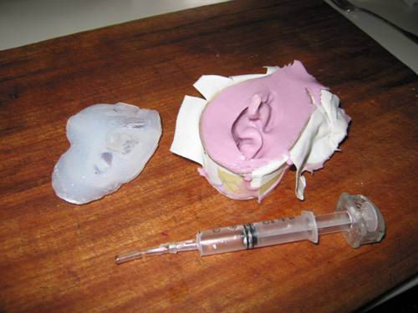
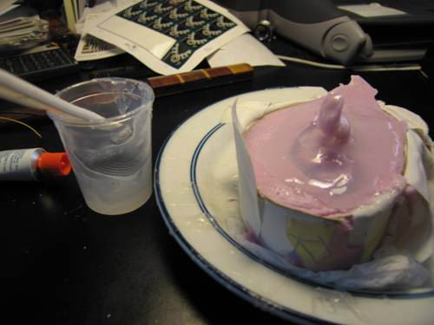
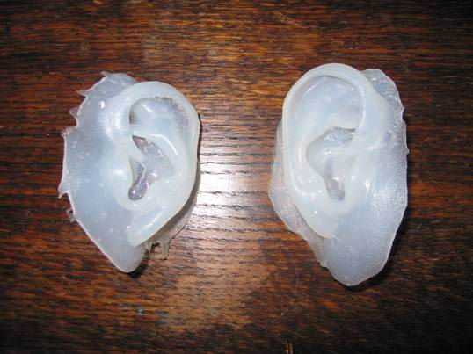
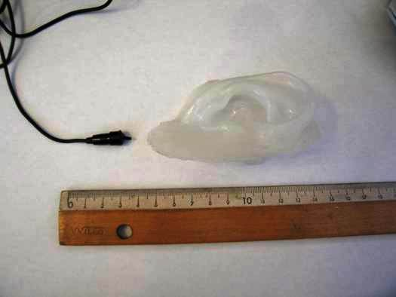
Pinna and ear canal casting:
Pinna and ear canal are filled with a water-based alginate gel. The resulting mold is immediately covered with vacuum degassed silicone to produce a positive cast.

Slide 29
More on casting
The silicon material was “Dragon-Skin” from Smooth-On with hardness of Shore 10.
The cured silicon positives are covered with more silicon to produce a durable negative for further reproduction.
The outside surface of the silicon pinna are cut away with a small scissors to reproduce the compliance of a real pinna, which varies from shore 3-10.
Tiny probe microphones are attached to the apex of the eardrum cavity, and a resistance tube of about 3m in length is attached to the center of the eardrum to simulate the eardrum resistance. 18 gage PVC was used.
  The probe microphones were calibrated to be flat to about 14kHz as referenced to a B&K 4133.
  DSP is used on the microphone outputs to apply the resulting equalization.
  The result matches probe measurements of my own ears within about 2dB.
Paraffin wax is used to fill the space inside the head around the ear canal and resistance tube to eliminate microphonics.
The outer head was cast with a high-density artist’s foam material from Smooth-On. This material is easily formed and cut.

Slide 30
Head Internal Equalization
The small probe microphones in the head have a Helmholtz resonance around 3kHz
  When this is added to the ear-canal and concha resonance the result is >20dB boost at 3kHz.
  These high sound pressures cause the microphones to clip.
To avoid clipping the microphones were modified to be 3 terminal source-followers instead of amplifiers.
  A resonant filter was added to produce a moderately frequency-independent output.

Slide 31
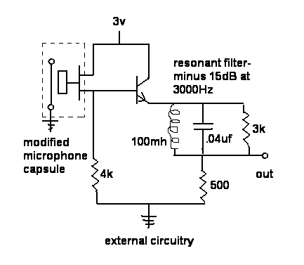
Head resonant filter circuit
Capsule IC draws about 200ua, with another 200ua for the transistor. Both channels together draw about 1ma from the batteries –
Battery life is essentially shelf life.
Output impedance is less than 500 ohms, with a peak voltage output of +-200mv.
No clipping observed with music signals > 100dBA.

Slide 32
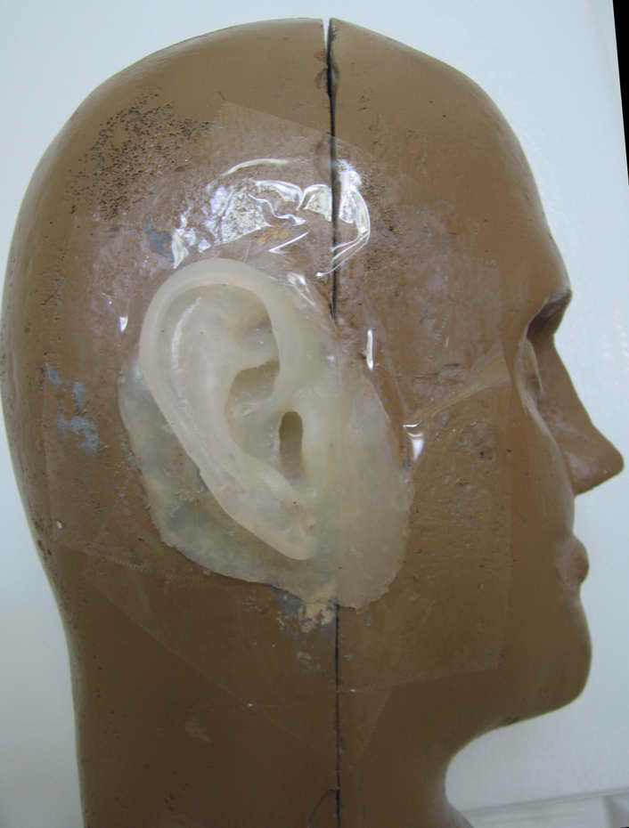
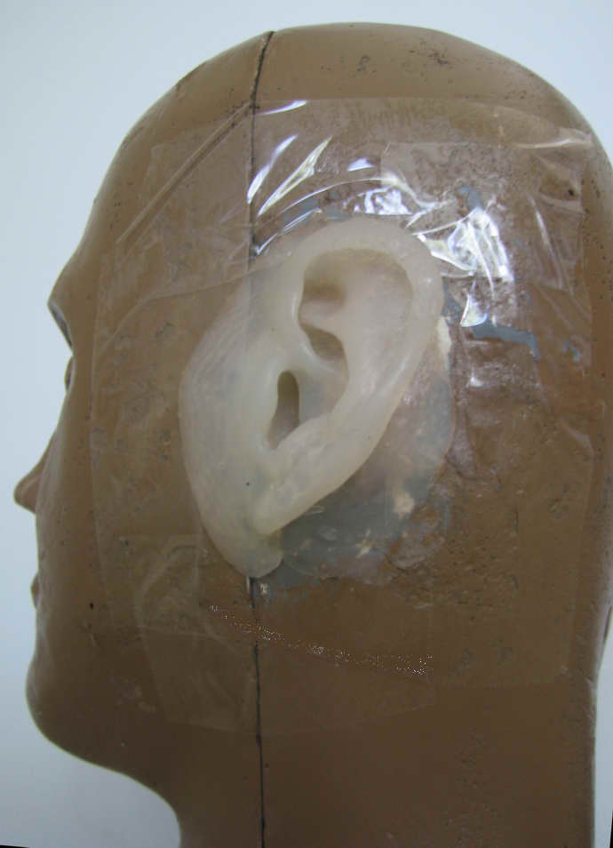
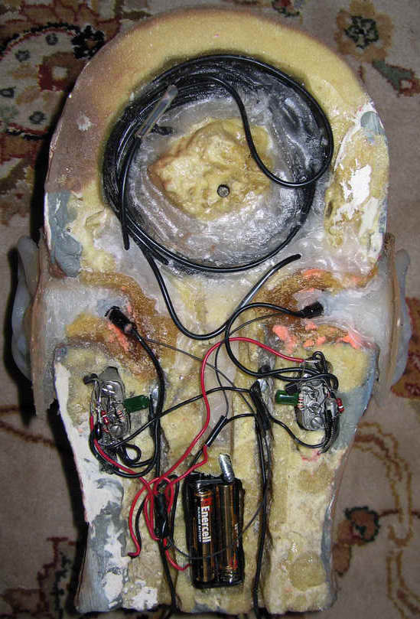
Completed head

Slide 33
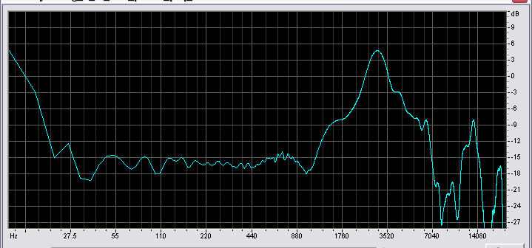
Eardrum pressure at 0 elevation
Eardrum pressure at dg’s left eardrum for a frontal sound source.
Note the sharp resonance at ~3000Hz, and a broad boost also at 3000Hz. There is a deep dip around 7800Hz.
How can it be that we perceive this as “flat”?
Hold this question for a bit – I will get back to it!

Slide 34
Eardrum pressure equalized
Although the previous curve looks complicated, it is basically a combination of two well-known resonances.
  One at ~3000Hz with a Q of ~3.5 and a peak height of 10dB
    This is due to a tube resonance in the ear canal, and is strongly influenced by the eardrum impedance
  One at ~3200Hz with a Q of ~.7 and a height of 9dB. This is due to the collection efficiency of the concha.
  There is an elevation dependent notch at 7800Hz due to a reflection off the back of the concha
If we apply two parametric sections with these parameters the result is remarkably flat!

Slide 35
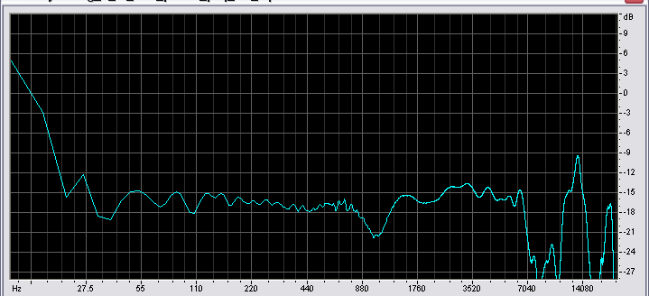
Picture of pressure response at the eardrum after simple parametric eq
A major advantage of a dummy head with ear canals is the simplicity – and understandability – of the response curves!
  Blocked canals are more difficult to correct.
  Recordings made with this EQ sound very good on loudspeakers

Slide 36

Adaptive Timbre – how do we perceive pink noise as “flat”
Pink noise sounds plausibly pink even on this sound system.
Let’s add a single reflection:
  The result sounds colored, with an identifiable pitch component.
But now play the unaltered noise again.
  The unaltered noise now has a pitch, complementary to the pitch from the reflection.

Slide 37
The “expectation”
The hearing system continually corrects the perceived frequency response to match the properties of the environment.
  This adaptation may take place in the basilar membrane itself.
Like all agc systems there are limits to the accuracy of the adaptation.
  In a quiet environment the gain of each critical band tends to increase to a maximum
  Where sound pressure is high, gain is reduced in a way that tends to equalize the power spectrum.
But there are limits both to the maximum gain, and to the maximum gain reduction in each critical band.
When headphones are worn, the brain adapts to them over a period of ~10 minutes.
  The time constant is just a guess. Barbara Shin-Cunningham finds this is the time required for the brain to improve speech comprehension in the presence of disturbing reflections.
    Sean Olive believes headphone timbre is adaptive over a period of perhaps 20 seconds.
  But correct localization and out-of-head perception are not (usually) achieved.
    With effort and concentration on what you expect, localization will also adapt. For me this takes about 5 minutes.

Slide 38
Loudness matching experiments
IEC publication 268-7 and German Standard DIN 45-619 do not recommend physical measurement for headphones, but recommend loudness comparison using 1/3 octave noise instead.
  These recommendations were superseded by diffuse field measurements as suggested by Theile.
Should these methods be revived? – I believe the answer is yes.
By measuring the eardrum pressure with a probe it is possible to equalize a headphone for flat pressure response at the eardrum.
  But when we play pink noise through such a headphone the sound is unpleasant. We need more energy in the 3kHz region to match the pressure response of the outer ear.
  How much extra energy? We can attempt to find out through loudness matching with noise.

Slide 39
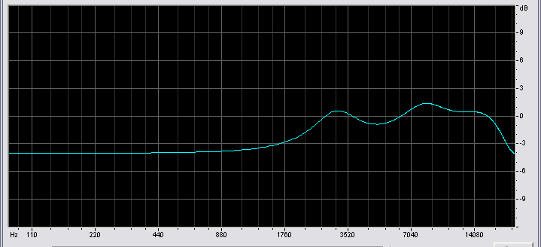
Quiet 1/3 octave expectation
In a quiet room using 1/3 octave noise with 500Hz as a reference, the above eq gives approximately equal loudness – using headphones equalized for constant sound pressure at the eardrum.
Note the correction needed is relatively small – about 6dB.
This represents the maximum gain of the AGC system, and it may result from losses in the middle ear.
When recordings made at the eardrum are played through earphones equalized for equal sound pressure, the timbre seems too bright for several minutes. Adaptation is part of our normal aural experience.

Slide 40
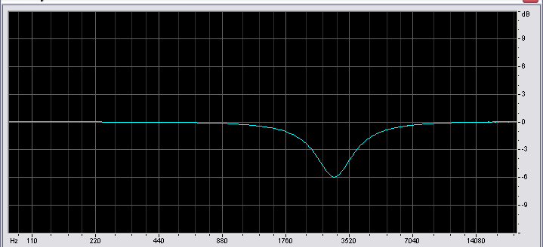
Correction needed for music
What if we do the identical experiment, but use a loudspeaker in front of the listener, accurately calibrated to produce frequency linear pink noise?
Surprisingly, the listener produces (on average) the following curve:
This is a 6dB drop at 3000Hz with a Q of 2. If we add a complementary boost to a headphone equalization based on equal loudness, the result is amazingly similar to a loudspeaker on ordinary recorded music. The loudspeaker and the headphones have the same timbre.

Slide 41
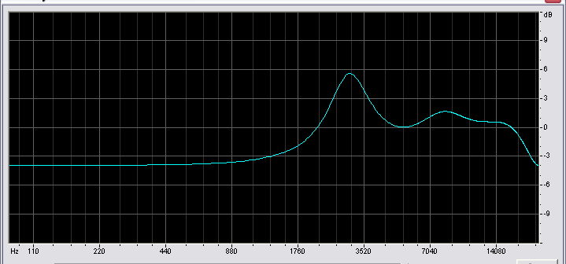
What about a dummy recording?
If we combine the two curves above – that is the quiet expectation, and the frequency boost needed to match loudspeaker reproduction, we get a curve that looks like this:
A recording made at the author’s eardrum with probe microphones that have a flat frequency response can be corrected with the inverse of this curve. This recording then sounds remarkably good on loudspeakers, and plays correctly through headphones equalized with the above curve.

Slide 42
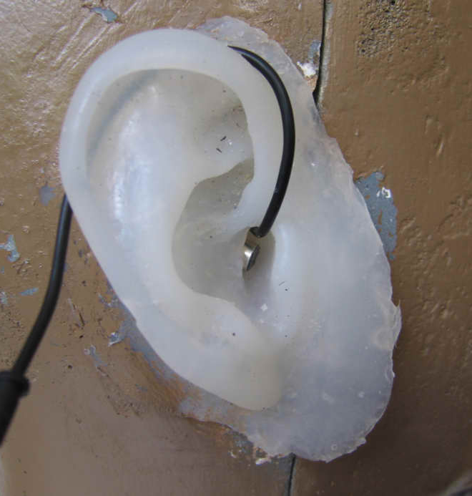
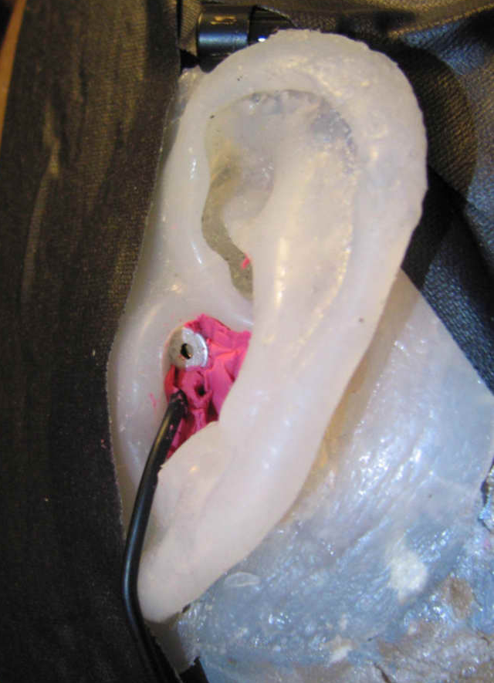
HRTFs from blocked ear canals
Here are pictures of a partially blocked canal (like Theile’s) and a fully blocked canal. The following data applies to the fully blocked measurements, although the partially blocked measurements are similar.

Slide 43
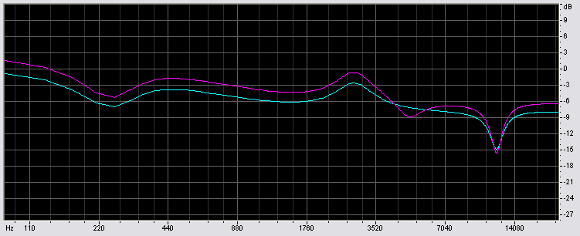
Blocked measurements vs eardrum
To compare the two measurement methods, I equalize the blocked measure of a single HRTF to the same HRTF measured at the eardrum. I chose the HRTF at azimuth 15 degrees left, and 0 degrees elevation.
The equalization required at least 3 parametric sections.
Blue – left ear, red – right ear

Slide 44
Equalized blocked HRTFs compared to a complete ear canal
Once the equalization was found, a set of equalized blocked HRTFs were compared to the identical directions measured at the eardrum.
The following graph shows 12 difference curves, plotted every 15 degrees in the horizontal plane.
Only the ipselateral curves are plotted
Note the differences are small up to a frequency of 8000Hz.
  When the microphone is placed deeper into the ear canal the frequency at which differences appear goes up – to about 10KHz.

Slide 45
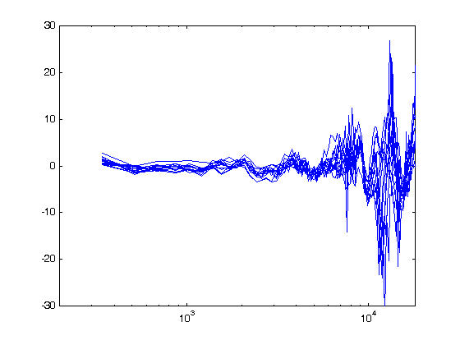
HRTF differences blocked to eardrum
These difference curves suggest that the directional properties of the measured HRTFs are preserved in the blocked measurement, at least to a frequency of ~8kHz. Above this frequency ear drum measurements appear to be necessary. - Although directional properties are correct, timbre is not correct

Slide 46
Headphone measurement with blocked ear canals
While it appears possible to measure directional differences with a blocked ear canal, it is NOT possible to accurately measure the timbre of headphones.
The following graphs show the difference between headphone response curves measured with an equalized blocked ear canal, versus the same headphones on the same pinnae, but at the eardrum.
There are significant differences in all the curves – even for relatively open earphones such as the AKG 701.
The bottom line is – earphones equalized using eardrum measurement sound far more natural than other techniques.
Note that these curves are NOT headphone response curves. They only show the differences between measurement methods!

Slide 47
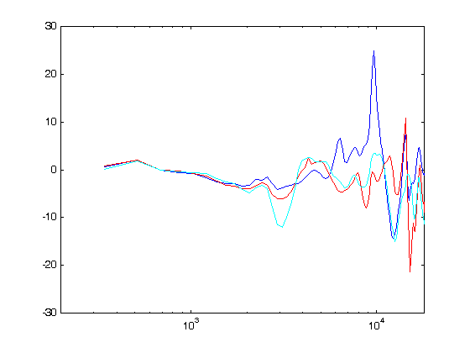
Headphone equalization differences blocked vs eardrum
Using the same method, I measured three headphones. Blue is the AKG 701, red is the AKG 240, and Cyan is the Sennheiser 250

Slide 48
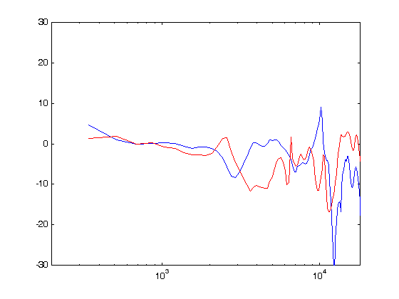
More blocked vs eardrum measurement differences
Blue – and old but excellent noise protection earphone by Sharp. Red – Ipod earbuds. Note the ~10dB error at 2500Hz for the ipod earbud.

Slide 49
Analysis
Note differences of 10dB in frequency ranges vital for timbre are present for almost all the examples shown.
We can conclude that it is possible to use anthropromorphic dummy heads with microphone couplers for recordings –
  IF AND ONLY IF it is possible to equalize them to a reference with ear canals.
  Such a reference is usually not available.
We can with more assurance conclude that it is NOT possible to equalize headphones with a physical measure that does NOT include an accurate ear canal.
In addition I have found that for many earphones it is vital to have a pinna model with identical compliance to a human ear.
  Particularly on-ear headphones alter the concha volume in a way that depends on the pinna elasticity.
  drastic changes in the frequency response can result.

Slide 50
Octave Band Loudness Matching
It IS possible to subjectively equalize headphones for a most motivated listeners.
  Playing a file of pink noise that alternates between octave bands while adjusting an octave-band equalizer for equal loudness.
  The results are quite different for different individuals.

Slide 51
Fun
You can make fantastic recordings with two probe microphones on your eardrums.
  I am continuing to make location recordings with concealed probe microphones.
    The tubes to the eardrums are comfortable and nearly invisible.
    With calibrated earphones the results can be spectacular.
These recordings – with headphone calibration – fulfill the goals of the original work by Schroeder to compare different seats in concert halls with accuracy.
  These recordings are vital for concert hall research, because due to adaptation an accurate memory of the timbre of a hall or a particular seat is impossible to achieve.
Ask for a listen!
  Even without individual calibration the results can be very interesting.

Slide 52
Conclusions
Dummy head recordings from heads with anthropromorphic pinna can give good results if the head is properly equalized
  and headphones can be matched to an individual listener.
  Finding the correct equalization for the dummy can be difficult – but can sometimes be done by spectral analysis post-recording.
All available dummy head models will give inaccurate results when used to equalize headphones.
Headphones can be accurately equalized for a particular listener using eardrum pressure measurements with probe microphones.
  Or using a dummy head with accurate ear canals.
  Such an equalization appears to sound better for most listeners than other available alternatives.
Loudness matching appears to be a viable alternative for matching headphones to an individual listener without invasive probes.
With some luck an individual headphone equalization can give frontal localization and realistic reproduction of timbre from non-individual recordings.

